Slide 1




Project
Presentation
Prepared by
Omolara Elizabeth Bello

Slide 2




Slide 3
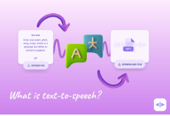
Introduction to Text-to-Speech
Text-to-Speech, or TTS, is a technology that converts written text into spoken words. Think of it as a digital voice that can read any text on a screen, document, or website

Slide 4
Methodology
The process generally involves two main steps:
How It Works
Text Analysis: The system first processes the raw text. It identifies sentence breaks, punctuation, and abbreviations. This step helps the system understand the structure and meaning of the text.
Speech Synthesis: This is where the magic happens. The system uses various methods to generate the audio. Modern TTS uses more advanced techniques AI to create a more natural-sounding voice with proper pitch, tone, and rhythm.

Slide 5

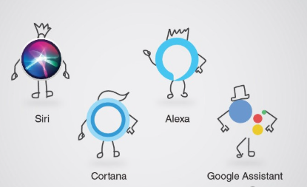

Applications
Accessibility:
It helps people with visual impairments or reading disabilities access digital content.
Smart Assistants:
Virtual assistants like Siri, Alexa, and Google Assistant use TTS to respond to your queries.
Navigation:
GPS systems use TTS to provide turn-by-turn directions without the driver having to look at the screen.

Slide 6
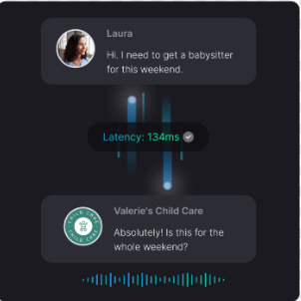


Applications
Customer Service:
Automated phone systems and chatbots use TTS to interact with customers.
E-learning:
It's used in educational apps and platforms to read lessons and textbooks aloud.
Public Announcements:
It’s useful at airports, train stations, or hospitals. It keeps everyone informed without needing a human to keep repeating messages.

Slide 7
Advantages & Limitations
Advantages
Limitations
Unnatural Sound: Despite advancements, some TTS voices can still sound robotic or unnatural, especially when dealing with complex emotions or tones.
Pronunciation Issues: It can struggle with pronouncing foreign names, technical terms, or homographs (words with the same spelling but different meanings and pronunciations).
Contextual Errors: The system may sometimes misinterpret the context, leading to incorrect intonation or emphasis. E.g Address, Match, Mean, e.t.c.
Increased Accessibility: Makes information available to a wider audience, including those with reading difficulties.
Multitasking: Allows users to listen to content while doing other tasks.
Convenience: Provides a hands-free way to consume information.

Slide 8
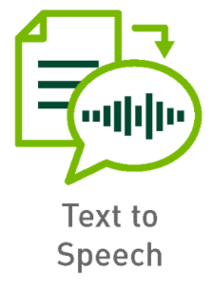
Result
https://colab.research.google.com/drive/1Em3BRbsaP5eLu2TDo9pCQBRM1y9ORZXn?usp=sharing

Slide 9

TTS is a powerful and versatile technology that continues to evolve. While challenges with naturalness and context remain, its benefits in accessibility and convenience are undeniable. As AI and machine learning advance, we can expect TTS to become even more indistinguishable from human speech.

Slide 10
Thank You

